Slide 1
Face Detection Based Door Unlock System by IOT
Guided By
Prof. Partha Bannerjee

Slide 2
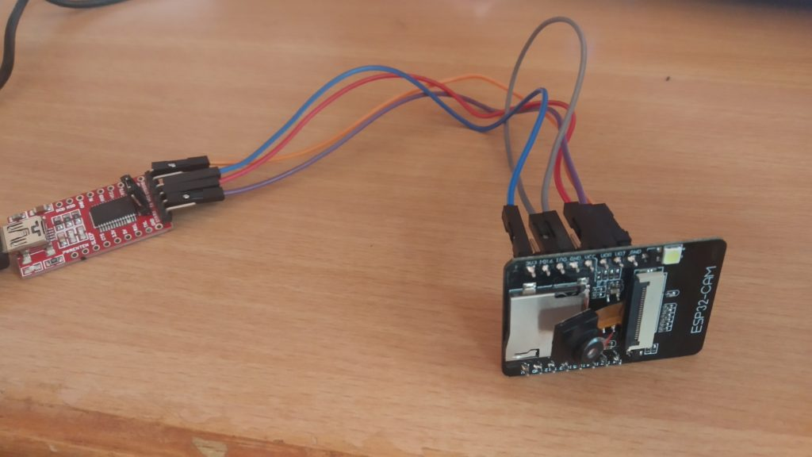
A Power-Point Presentation for fulfilment of Bachelor Of Technology in Electronics & Communication Engineering .
Presented By
Vikash Mahato(16900317001)
Tamojit Saha(16900317002)
Tamal Mandal(16900317003)
Subhayan Bhowmick(16900317005)

Slide 3
Contains:
Introduction
Internet Of Things
IOT & ESP32 CAM
NODE MCU ESP32-Cam
TTL Converter
Stepper Motor-SG90
Motor Driver-L298
Components Connection
Working Diagram
Dataflow Diagram
Output
Webpage Access
Database Access
Applications
Advantages
Disadvantages
Future Works
Conclusion
Reference

Slide 4
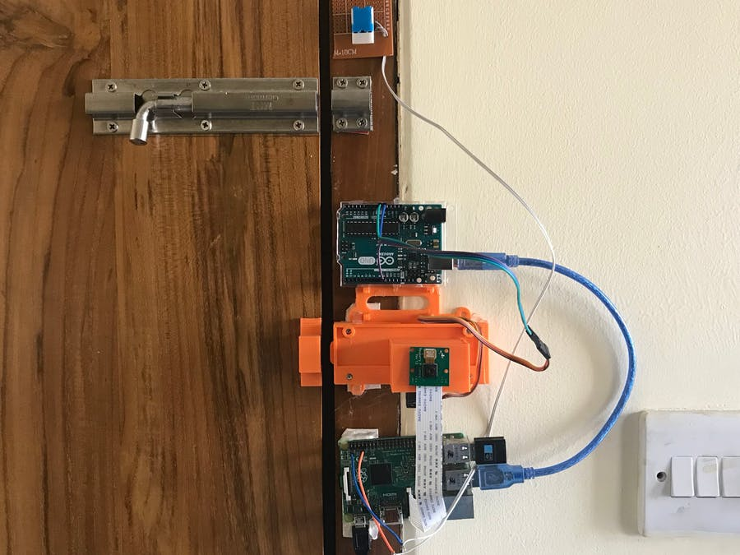
INTRODUCTION:
OBJECTIVE:
IOT based project
Home Automation Based Security System
Face Recognition Over Internet
More preferred in market nowadays.

Slide 5
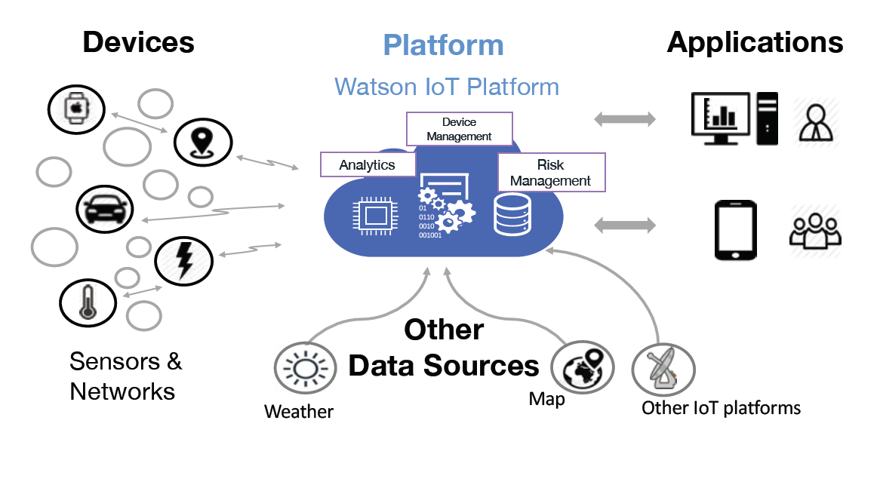
Internet Of Things:
SENSORS & ACTUATORS
CONNECTIVITY
PEOPLE & PROCESSES

Slide 6
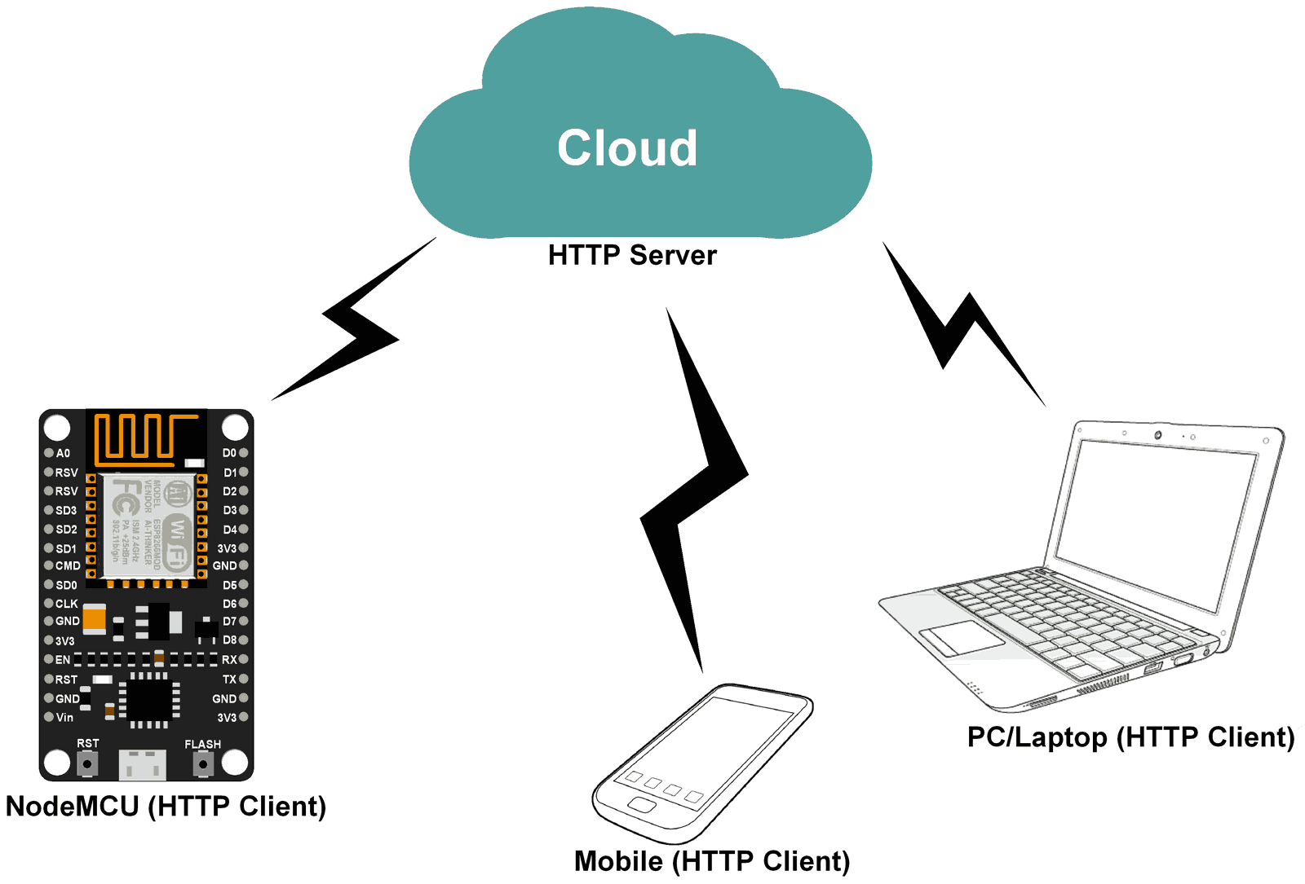
How IOT work with MCU Chip ESP32
Sensor
IDE(Audrino Eclipse)
Coding
Web
Database

Slide 7
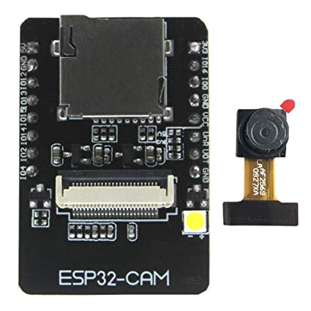
ESP32-CAM:
Low power 32-bit CPU
Up to 160MHz clock speed
Built-in 520 KB SRAM, external 4MPSRAM
Support OV2640 and OV7670 cameras, built-in flash lamp

Slide 8
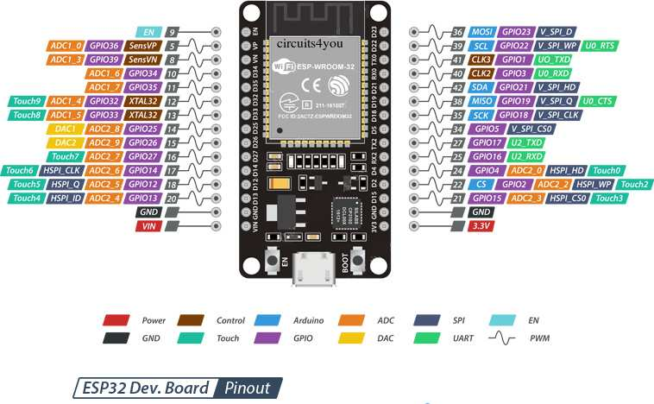

Pin Configuration:

Slide 9
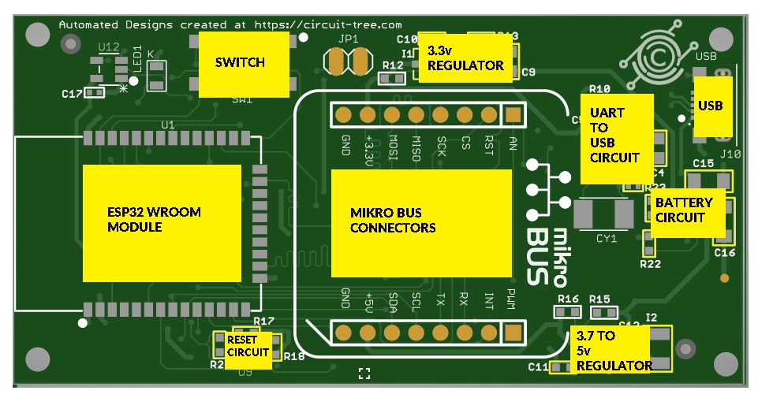
Circuit Diagram:
34 × programmable GPIO
12-bit SAR ADC up to 18 channels
2 × 8-bit DAC
10 × touch sensors
4 × SPI
2 × I²S
2 × I²C
3 × UART
1 host (SD/eMMC/SDIO)
1 slave (SDIO/SPI)

Slide 10
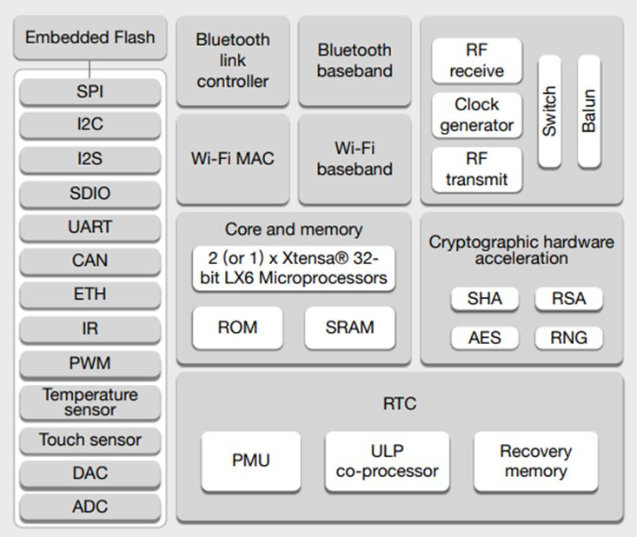
Internal Diagram of ESP32 cam:

Slide 11
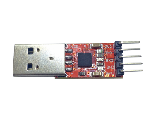
TTL Converter
3.3V / 5V TTL signal
converts to RS232 signal
TX, RX, +5/3.3V, GND
3 type

Slide 12
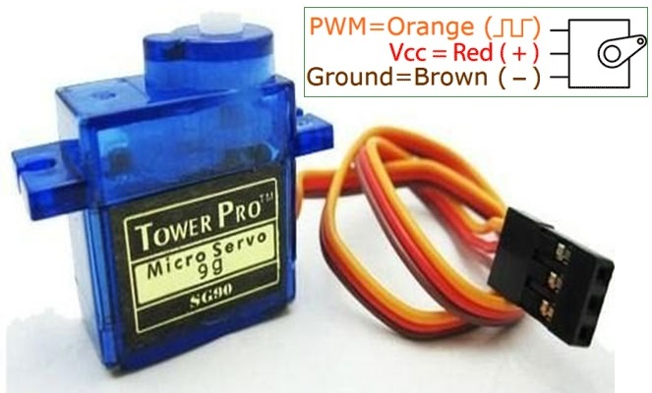
SG90 Servo Motor:
Operating Voltage +5V
Torque: 2.5kg/cm
Operating speed is 0.1s/60°

Slide 13
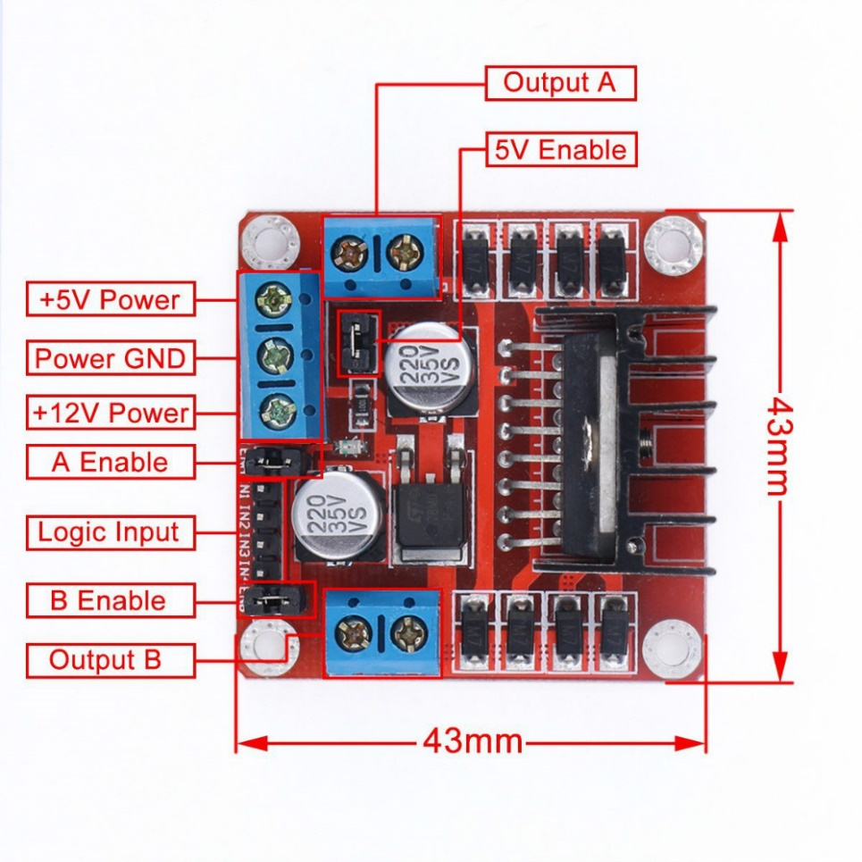
Motor Driver Module(L298):
Drive voltage: 5V-35V
Drive current: 2A
Weight: 26 gm

Slide 14
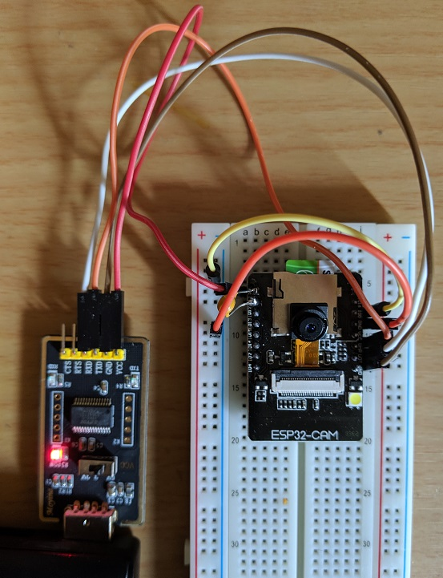
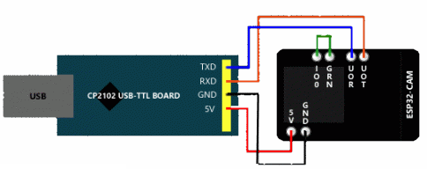
Connection Between Different Blocks
Fig 1: Circuit Diagram
Fig 2: Real Diagram

Slide 15
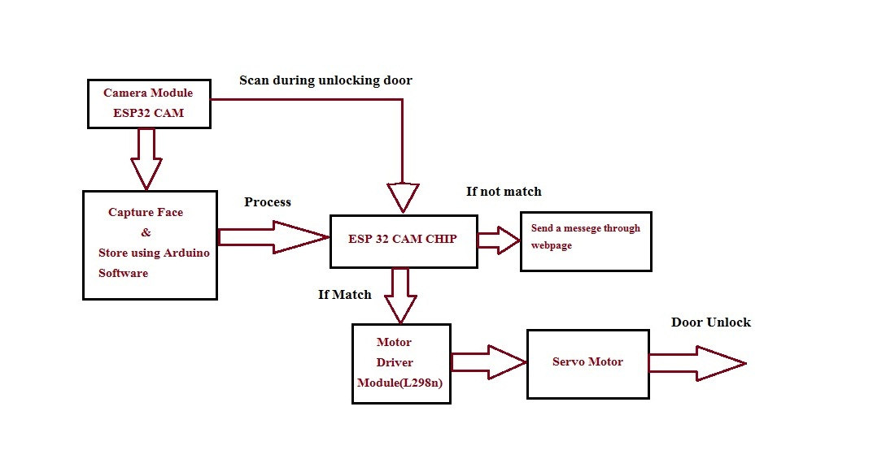
BLOCK DIAGRAM:

Slide 16
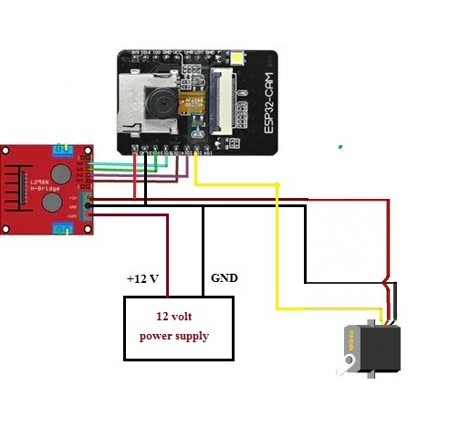
Circuit Diagram:

Slide 17
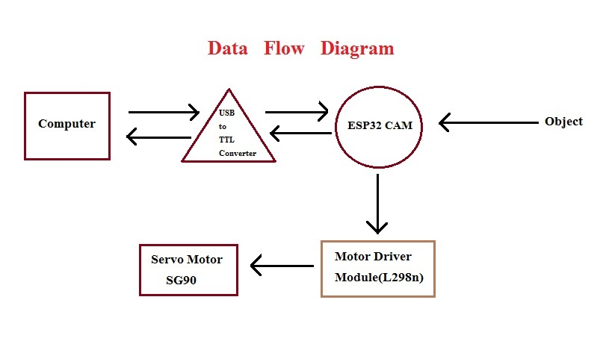
DATA FLOW DIAGRAM

Slide 18
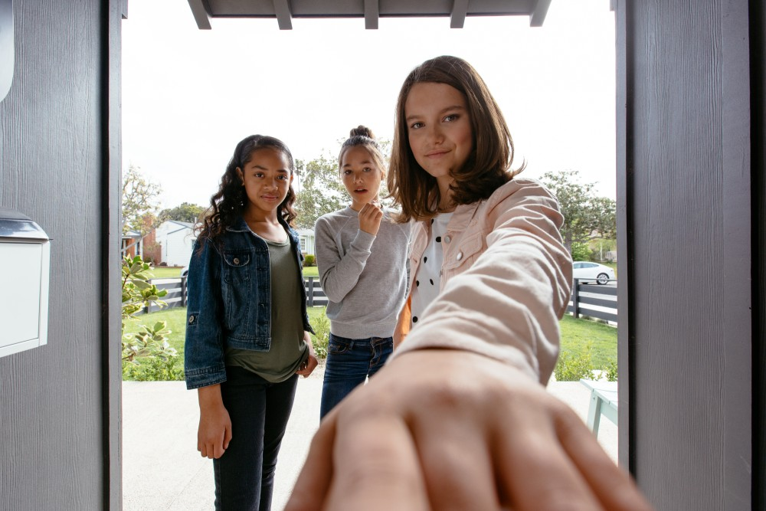
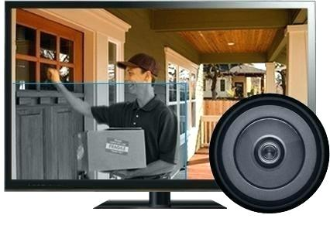
APPLICATIONS:
Automatic Access and security
Store multiple images in Database
Can Capture any unwanted things in front of door
Easily access from anywhere

Slide 19
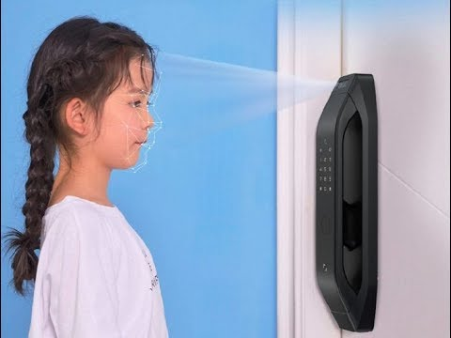
Advantages:
Improved Security
High Accuracy
Real Time Surveillance
Easy Integration Process
Cheaper than other conventional locks with such facilities
Nearly no false-positive face detection

Slide 20



Disadvantages:
Poor Internet Connection
Camera Angle
Power failure

Slide 21

FUTURE SCOPE:
Connect to cloud for storing video
Motion detection triggering mechanism
RFID Card based lock
AI based Face Detection Unlock

Slide 22
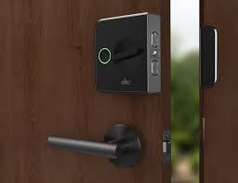
Conclusion:
Smaller, lighter and with lower power consumption
Cheaper than other security based systems with same features
Nearly no false-positive face detection

Slide 23
Bibliography:
https://www.espressif.com/en/products/hardware/esp32/overview
https://www.cytron.io/p-nodemcu-esp32
https://randomnerdtutorials.com/esp32-cam-video-streaming-face-recognition-arduino-ide/
https://www.electronics-lab.com/project/using-sg90-servo-motor-arduino/
https://www.instructables.com/id/ESP-32-Camera-Streaming-Video-Over-WiFi-Getting-St/

Slide 24
THANK YOU

